Slide 1
Researches that cite Dimas & Triantafyllou 1989
劉沁雅

Slide 2
Overview
Stability analysis | Simulation | Experiment
Instabilities of a horizontal shear flow with a free surface
Large eddy simulation of a flow past a free surface piercing circular cylinder
Evolution of a quasi-steady breaking wave
Internal-Shear Mode Instabilities on High-Speed Liquid Jet
Flow past a cylinder close to a free surface
Short surface waves on surface shear
Modal and nonmodal growths of inviscid planar perturbations in shear flows with a free surface
Surface ripples due to steady breaking waves
Nonlinear interaction of shear flow with a free surface
Linear instability of a particle-laden mixing layer with a dynamic dispersed phase
Dimas
Free-surface waves generation by a fully submerged wake
1989
1993
1996
1997
1998
1999
Triantafyllou
Nonlinear interaction of shear flow with a free surface
The surface layer for free-surface turbulent flows

Slide 3
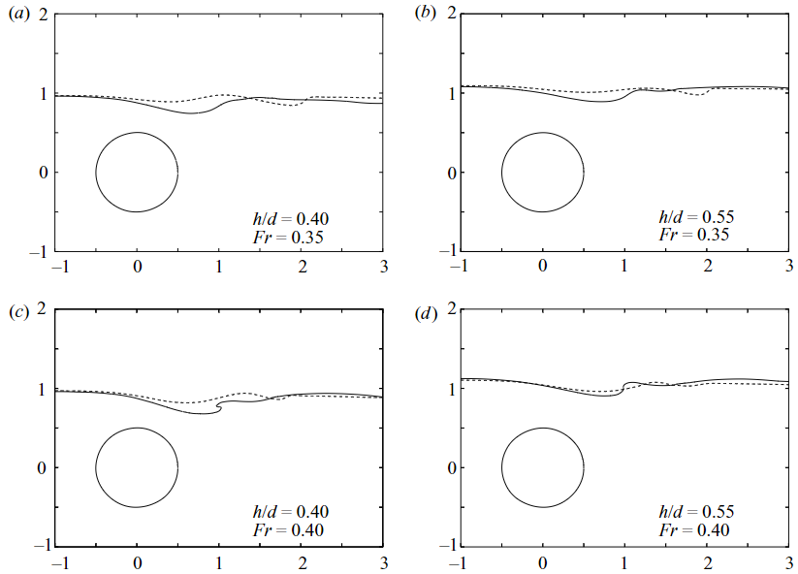
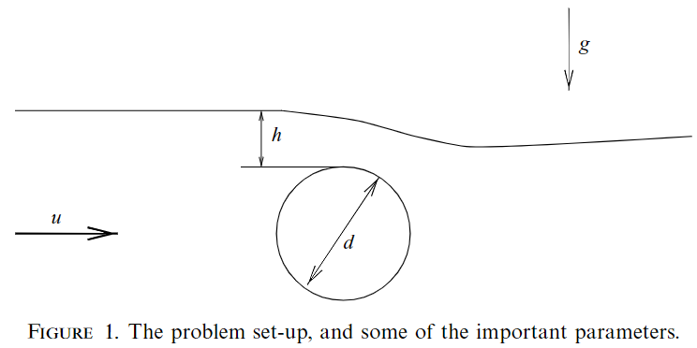
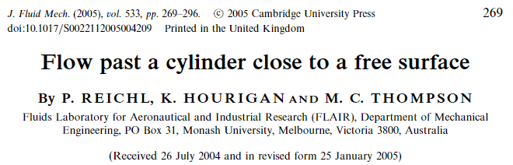
Flow past a cylinder close to a free surface - 1
Simulations with FLUENT, which uses finite-volume method, free surface is implemented by volume-of-fluid method. Results compared with experimental results.
Spatial discretization : QUICK (quadratic upstream interpolation for convective kinematics) method, second- order accurate overall. Temporal discretization : first-order accurate when the VOF method is employed.
Re = 180,
neglect surface tension
Return

Slide 4
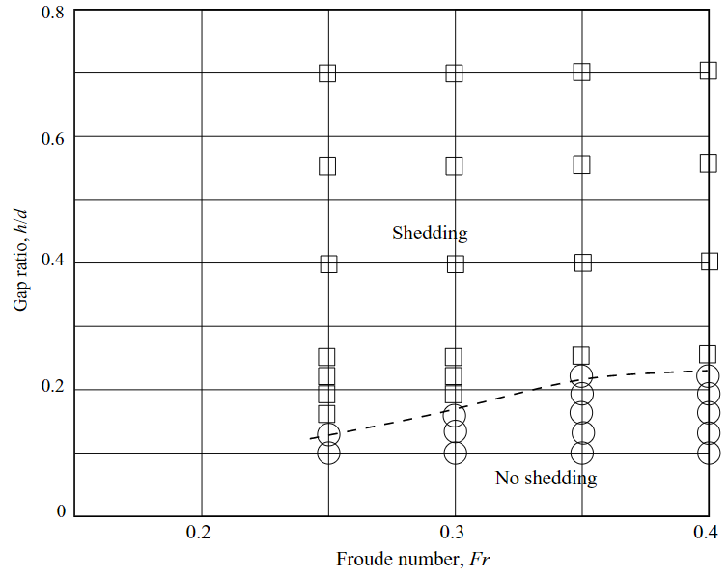
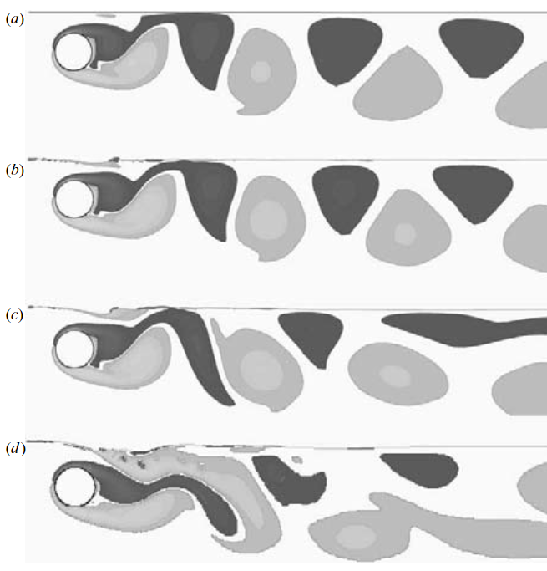
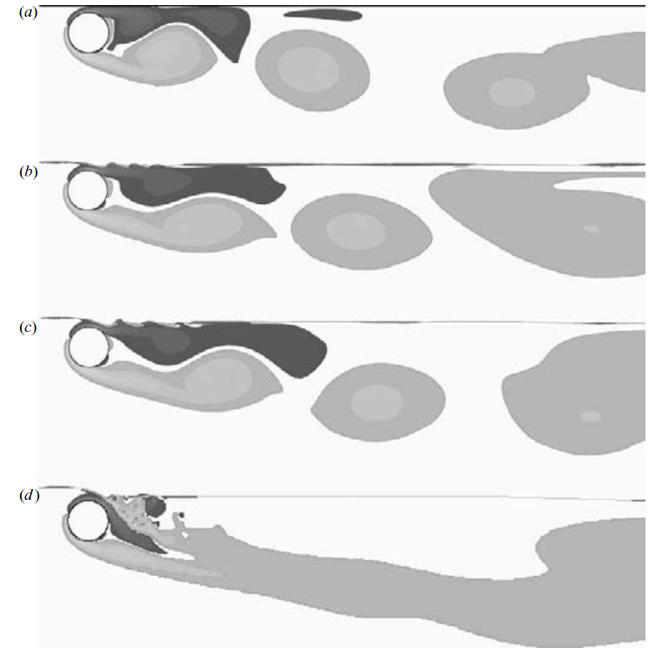










Flow past a cylinder close to a free surface - 2
“Triantafyllou & Dimas (1989) showed that in the extreme case where the cylinder is only half submerged, the wake instability changes from absolute to convectively unstable”
$$h/d=0.55$$
$$h/d=0.16$$
$$Fr=0$$
$$Fr=0$$
$$Fr=0.3$$
$$Fr=0.3$$
$$Fr=0.4$$
$$Fr=0.4$$
$$Fr=0.6$$
$$Fr=0.6$$
Return

Slide 5
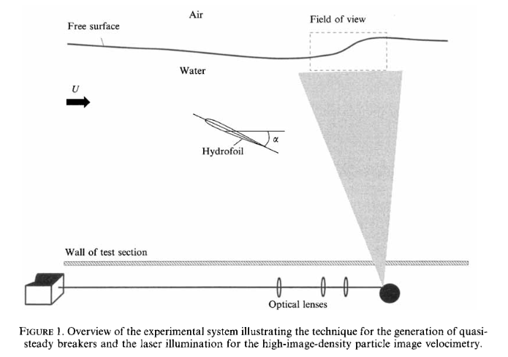
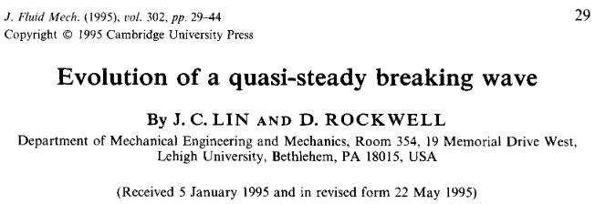
Evolution of a quasi-steady breaking wave
Experiments on a quasi-steady break wave.
“They describe the nonlinear evolution of two linearly unstable modes, which are dependent upon wavenumber and Froude number. The patterns of vortices formed beneath the crests and troughs of the free surface have distinctive features for each of the two modes; small deformations of the free-surface are related to the onset of breaking.“
Return

Slide 6
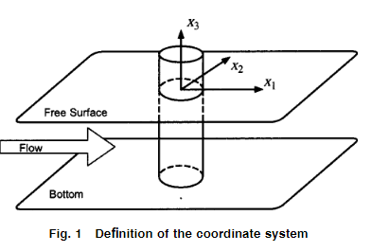
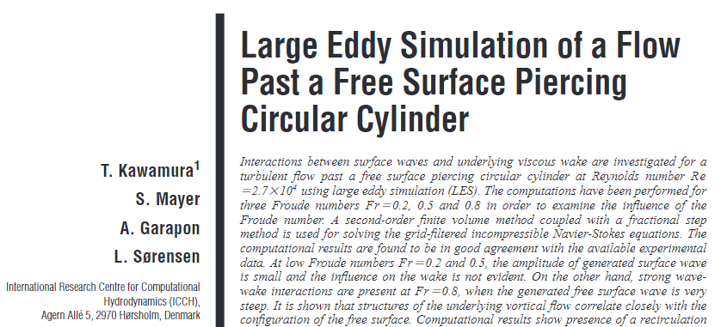
Large eddy simulation of a flow past a free surface piercing circular cylinder
Uses large eddy simulation (LES) to investigate the interactions between surface waves and underlying viscous wake.
“Triantafyllou and Dimas have analytically shown an instability of the wave-wake interaction about a horizontal cylinder piercing a free surface.”
Return

Slide 7
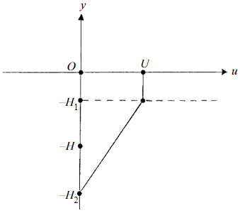
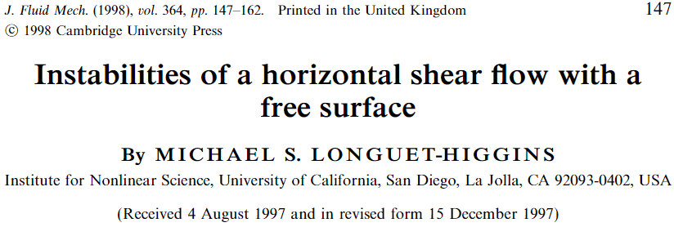
Instabilities of a horizontal shear flow with a free surface - 1
Stability analysis using a piecewise linear velocity profile.
Reason of using a piecewise linear velocity profile : “However, their method of calculation is elaborate and their numerical results are consequently incomplete. There seems to be good reason for adopting a much simpler model, representing the observed current profile almost equally well, but amenable to an analytical treatment.”
Lost of precision of this model : “…with the restriction that over some ranges of Froude number and depth ratio the two branches are found to merge.”
Return

Slide 8
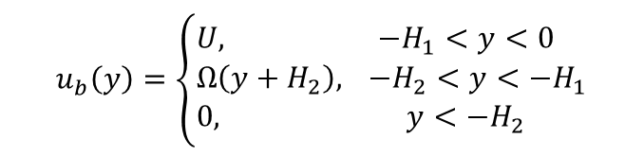


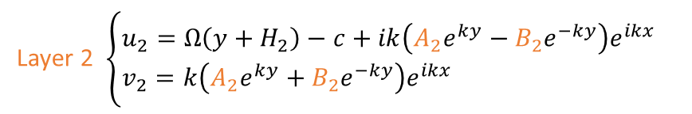
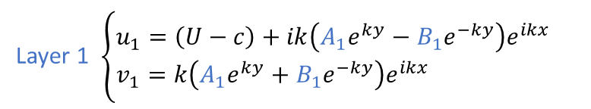

Instabilities of a horizontal shear flow with a free surface - 2
With $\frac{∂^{2}U}{∂y^{2}}=0$, solutions of the Rayleigh equation can be found analytically. $(U−c)\left(\frac{d^{2}φ}{dy^{2}}−k^{2}φ\right)−\frac{d^{2}U}{dy^{2}}φ=0$ ⟹ $φ=Ae^{ky}+Be^{−ky}, ψ=φe^{ik\left(x−ct\right)}=\left(Ae^{ky}+Be^{−ky}\right)e^{ik\left(x−ct\right)}$
Perturbed velocities : $u^{′}=\frac{∂ψ}{∂y}=k\left(Ae^{ky}−Be^{−ky}\right)e^{ik\left(x−ct\right)}, v^{′}=−\frac{∂ψ}{∂x}=−ik\left(Ae^{ky}+Be^{−ky}\right)e^{ik\left(x−ct\right)}$
Velocity in each layer (travelling with the phase speed) :
Layer 1
Layer 2
Layer 3
Layer 1 $\left\{\begin{aligned}&u_{1}=\left(U−c\right)+ik\left(A_{1}e^{ky}−B_{1}e^{−ky}\right)e^{ikx} \\ &v_{1}=k\left(A_{1}e^{ky}+B_{1}e^{−ky}\right)e^{ikx}\end{aligned}\right.$
$$u_{b}\left(y\right)=\left\{\begin{aligned}&U, &−H_{1}<y<0 \\ &Ω\left(y+H_{2}\right), & −H_{2}<y<−H_{1} \\ &0, &y<−H_{2}\end{aligned}\right.$$
Layer 2 $\left\{\begin{aligned}&u_{2}=Ω\left(y+H_{2}\right)−c+ik\left(A_{2}e^{ky}−B_{2}e^{−ky}\right)e^{ikx} \\ &v_{2}=k\left(A_{2}e^{ky}+B_{2}e^{−ky}\right)e^{ikx}\end{aligned}\right.$
Layer 3 $\left\{\begin{aligned}&u_{3}=−c+ikA_{3}e^{ky+ikx} \\ &v_{3}=kA_{3}e^{ky+ikx}\end{aligned}\right.$
$u,v→0$ as $y→∞$
Return

Slide 9
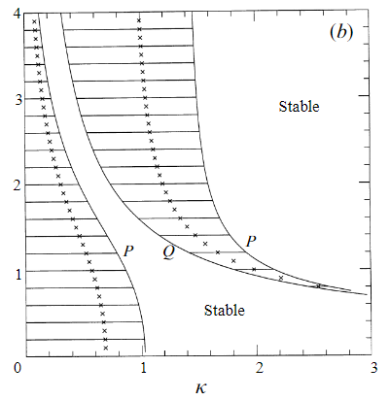
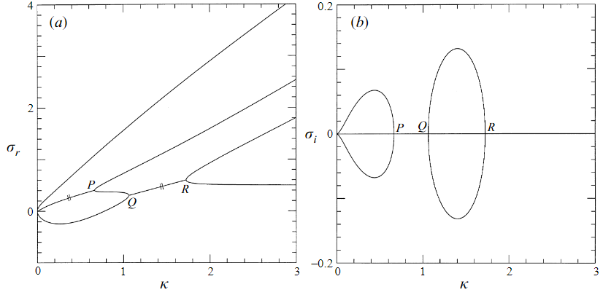


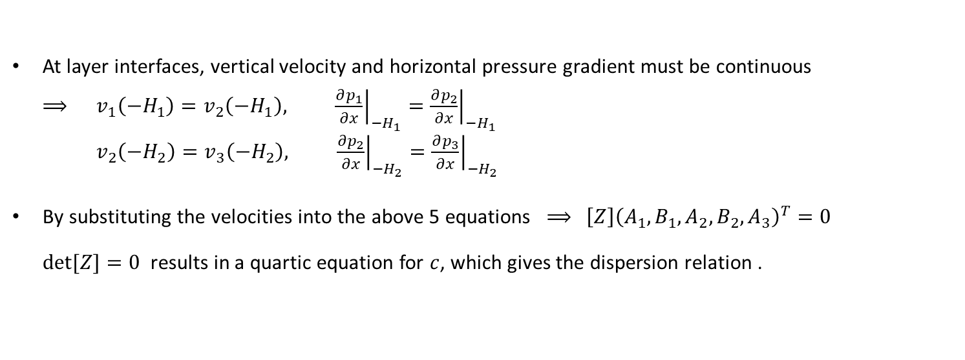
Instabilities of a horizontal shear flow with a free surface - 3
Kinematic and dynamic boundary conditions are combined into one equation (neglect surface tension, density is taken to be unity) ⟹ ${\left(U−c\right)}^{2}\frac{∂v}{∂y}=gv, y=0$
At layer interfaces, vertical velocity and horizontal pressure gradient must be continuous ⟹ $v_{1}\left(−H_{1}\right)=v_{2}\left(−H_{1}\right), {\left.\frac{∂p_{1}}{∂x}\right|}_{{−H}_{1}}={\left.\frac{∂p_{2}}{∂x}\right|}_{{−H}_{1}}$ $v_{2}\left(−H_{2}\right)=v_{3}\left(−H_{2}\right), {\left.\frac{∂p_{2}}{∂x}\right|}_{{−H}_{2}}={\left.\frac{∂p_{3}}{∂x}\right|}_{{−H}_{2}}$
By substituting the velocities into the above 5 equations ⟹ $\left[Z\right]{\left(A_{1}, B_{1}, A_{2}, B_{2}, A_{3}\right)}^{T}=0$ $det⁡[Z]=0$ results in a quartic equation for $c$, which gives the dispersion relation .
$$h_{1}=0.5$$
$$h_{1}=0.5, F=1.5$$
Return

Slide 10
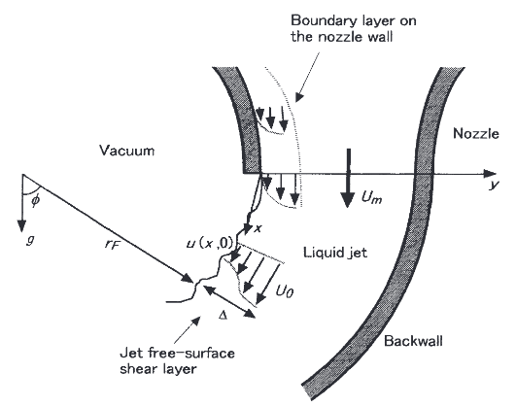
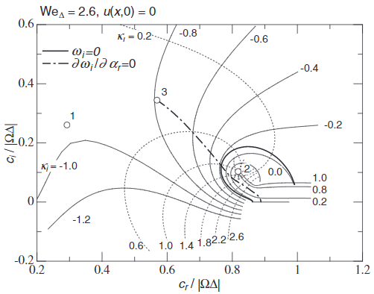
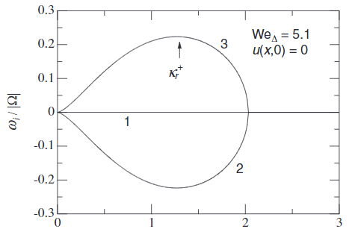
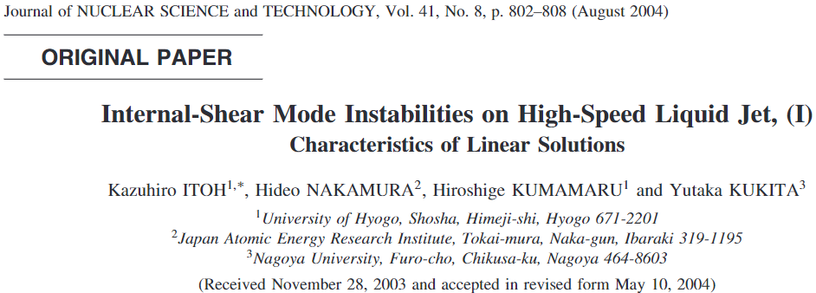





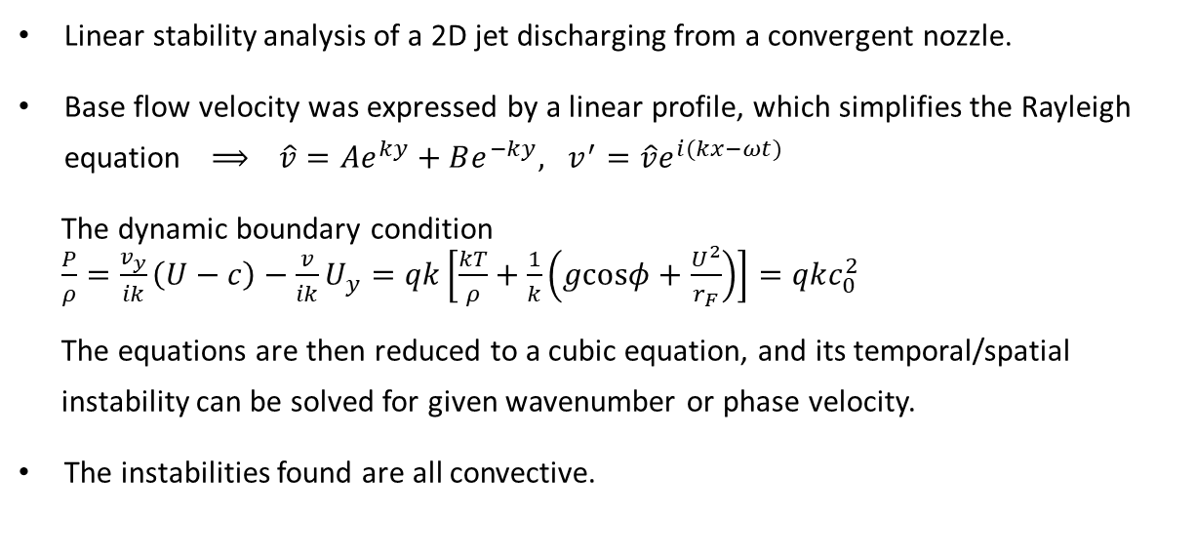
Internal-Shear Mode Instabilities on High-Speed Liquid Jet, (I) Characteristics of Linear Solutions
Linear stability analysis of a 2D jet discharging from a convergent nozzle.
Base flow velocity was expressed by a linear profile, which simplifies the Rayleigh equation ⟹ $\hat{v}=Ae^{ky}+Be^{−ky}, v^{′}=\hat{v}e^{i(kx−ωt)}$
The dynamic boundary condition $\frac{P}{ρ}=\frac{v_{y}}{ik}\left(U−c\right)−\frac{v}{ik}U_{y}=qk\left[\frac{kT}{ρ}+\frac{1}{k}\left(g\text{cos}φ+\frac{U^{2}}{r_{F}}\right)\right]=qkc_{0}^{2}$
The equations are then reduced to a cubic equation, and its temporal/spatial instability can be solved for given wavenumber or phase velocity.
The instabilities found are all convective.
$$u(x,0)$$
$$x$$
$$Δ$$
$$y$$
$$U_{0}$$
Return

Slide 11
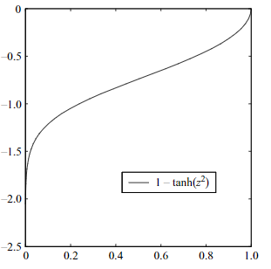
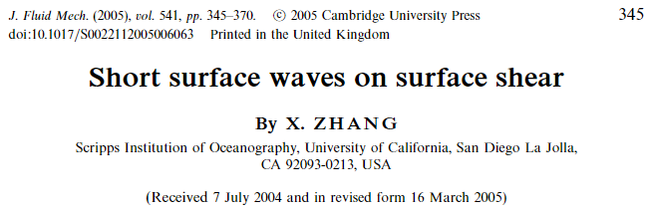
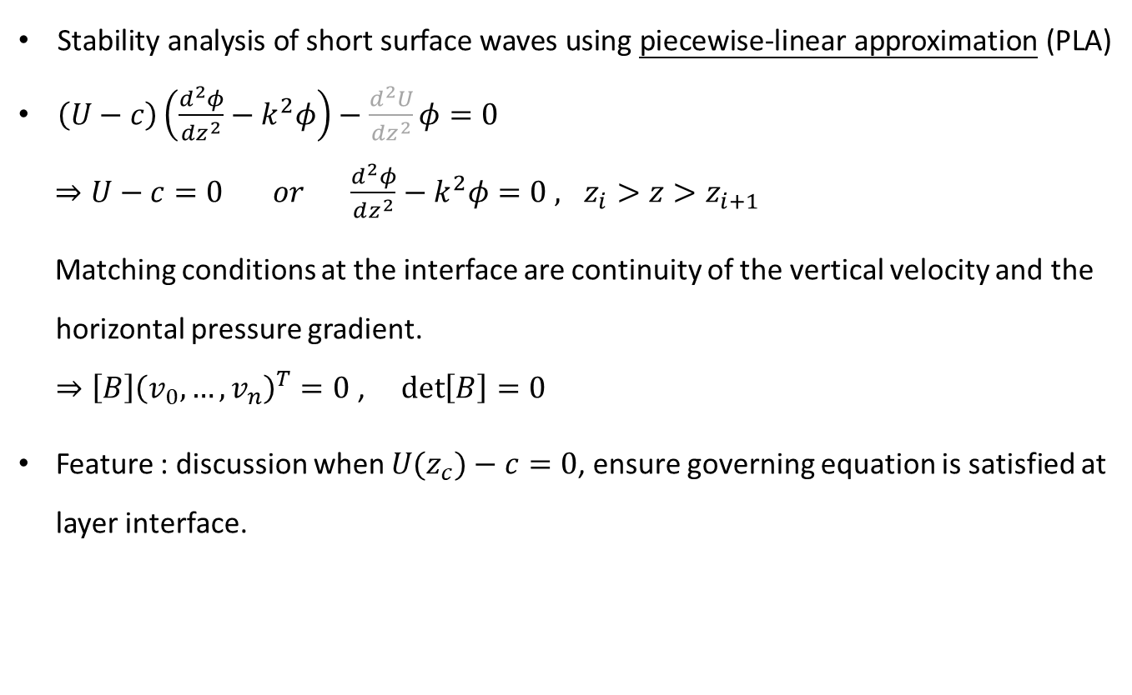
Short surface waves on surface shear
Stability analysis of short surface waves using piecewise-linear approximation (PLA)
$\left(U−c\right)\left(\frac{d^{2}φ}{dz^{2}}−k^{2}φ\right)−\frac{d^{2}U}{dz^{2}}φ=0$
$⇒U−c=0 or \frac{d^{2}φ}{dz^{2}}−k^{2}φ=0$ $, z_{i}>z>z_{i+1}$
Matching conditions at the interface are continuity of the vertical velocity and the horizontal pressure gradient. $⇒\left[B\right]{\left(v_{0},…,v_{n}\right)}^{T}=0$ , $\det\left[B\right]=0$
Feature : discussion when $U(z_{c})−c=0$, ensure governing equation is satisfied at layer interface.
Return

Slide 12
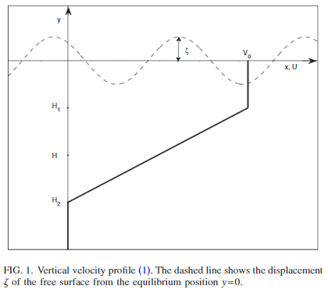
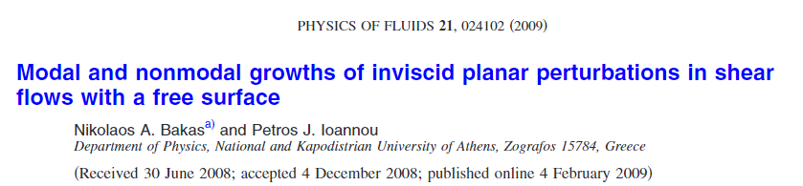
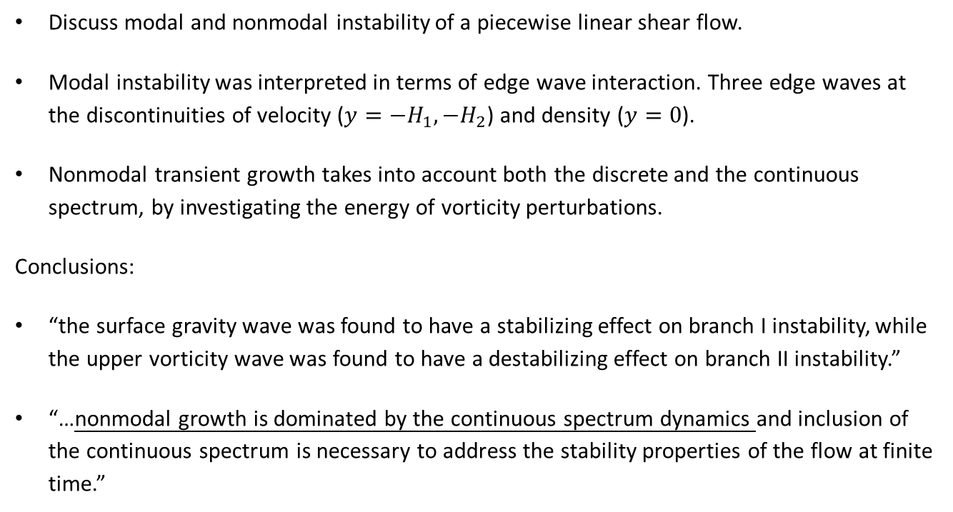
Modal and nonmodal growths of inviscid planar perturbations in shear flows with a free surface
Inviscid, incompressible
Discuss modal and nonmodal instability of a piecewise linear shear flow.
Modal instability was interpreted in terms of edge wave interaction. Three edge waves at the discontinuities of velocity ($y=−H_{1},−H_{2}$) and density ($y=0$).
Nonmodal transient growth takes into account both the discrete and the continuous spectrum, by investigating the energy of vorticity perturbations.
Conclusions:
“the surface gravity wave was found to have a stabilizing effect on branch I instability, while the upper vorticity wave was found to have a destabilizing effect on branch II instability.”
“…nonmodal growth is dominated by the continuous spectrum dynamics and inclusion of the continuous spectrum is necessary to address the stability properties of the flow at finite time.”
Return

Slide 13
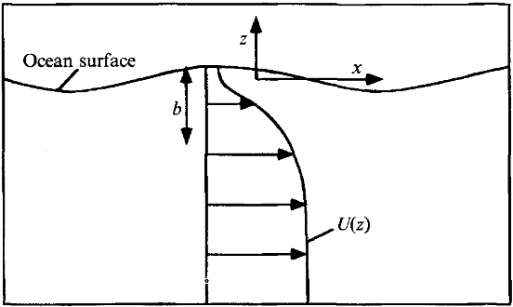
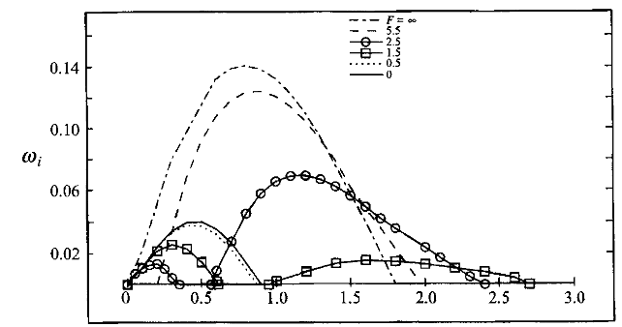
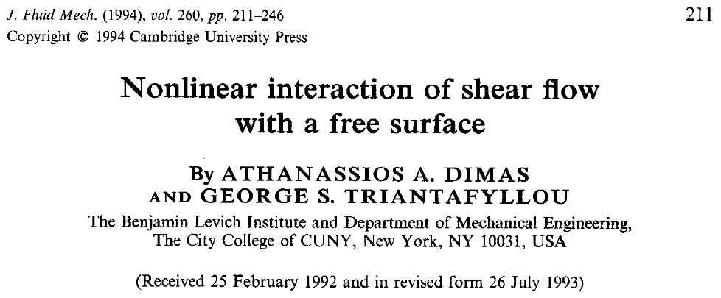
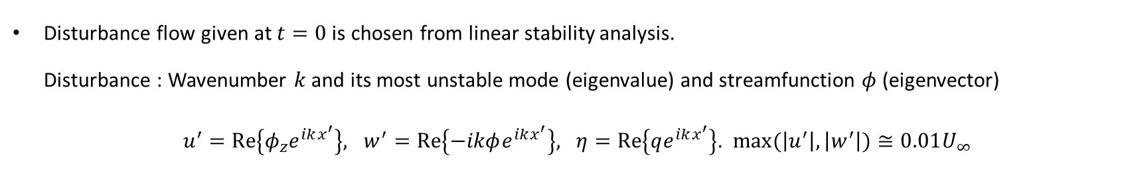
Nonlinear interaction of shear flow with a free surface - 1
Chebyshev
Simulation of nonlinear evolution of 2D inviscid wake flow.
Spectral discretization in space (streamwise : Fourier, vertical : Chebyshev), third-order Adams-Bashforth scheme in time.
Fourier
Disturbance flow given at $t=0$ is chosen from linear stability analysis. Disturbance : Wavenumber $k$ and its most unstable mode (eigenvalue) and streamfunction $φ$ (eigenvector)
$u^{′}=\text{Re}\left\{φ_{z}e^{ikx^{′}}\right\}, w^{′}=\text{Re}\left\{−ikφe^{ikx^{′}}\right\}, η=\text{Re}\left\{qe^{ikx^{′}}\right\}$. $max⁡(\left|u^{′}\right|,\left|w^{′}\right|)≅0.01U_{∞}$
Return

Slide 14
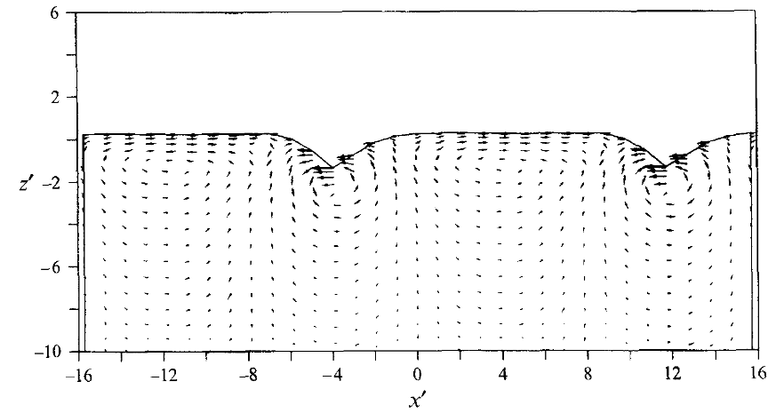
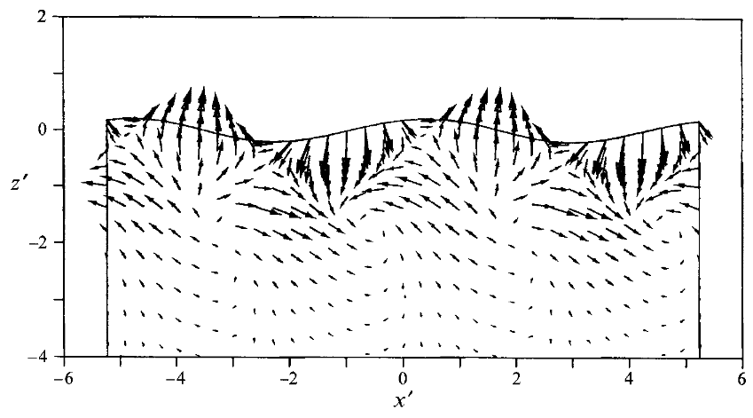
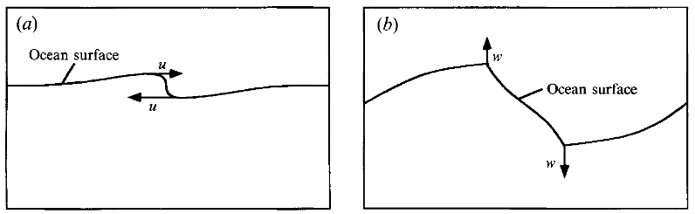


Nonlinear interaction of shear flow with a free surface - 2
“…the dynamics of Branch I waves seem to be dominated by the variation of the horizontal velocity at the free surface, whereas the dynamics of Branch II waves seem to be dominated by the variation of the vertical velocity at the free surface.”
“…the generation of stable propagating surface waves above a shear flow occurs at low Froude numbers for Branch II instability waves.”
$$Branch I, Fr=0.5$$
$$Branch II, Fr=2.5$$
Return

Slide 15
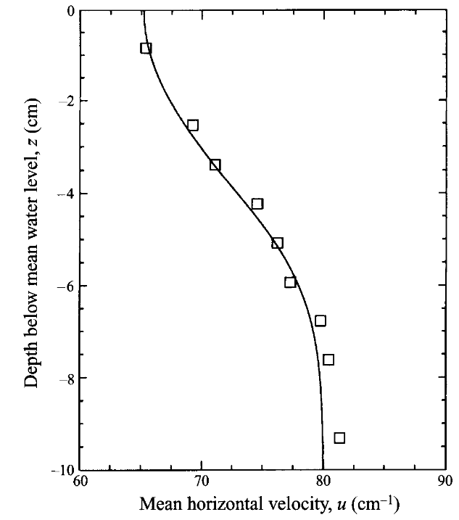
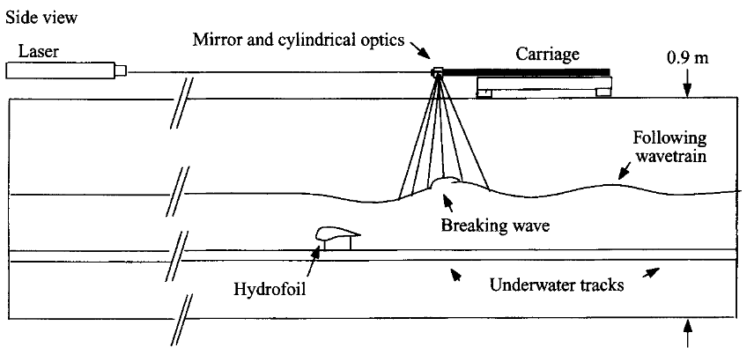
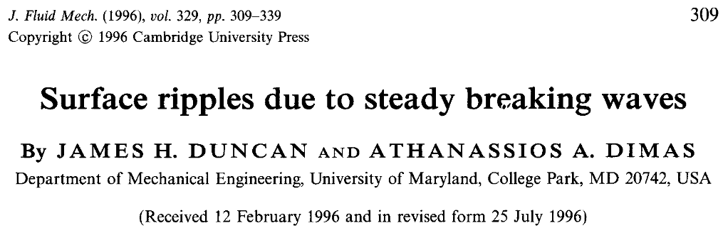
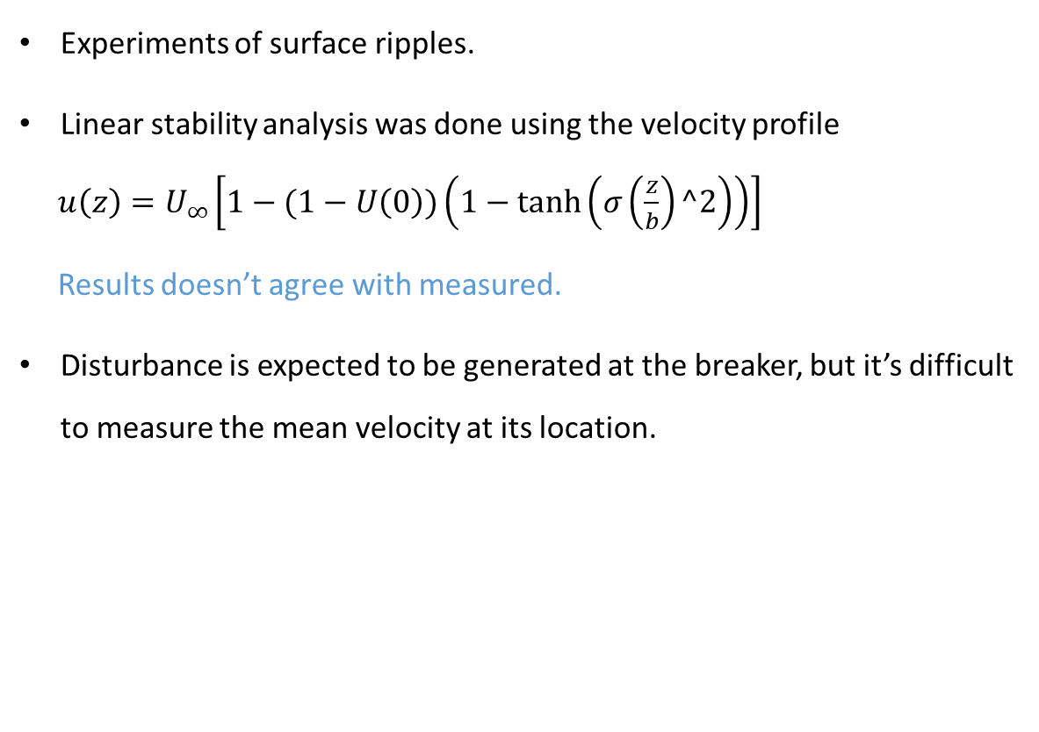
Surface ripples due to steady breaking waves
□ : measured velocity downstream
Experiments of surface ripples.
Linear stability analysis was done using the velocity profile
$u\left(z\right)=U_{∞}\left[1−(1−U\left(0\right))\left(1−\tanh\left(σ\left(\frac{z}{b}\right)^2\right)\right)\right]$
Results doesn’t agree with measured.
Disturbance is expected to be generated at the breaker, but it’s difficult to measure the mean velocity at its location.
Return

Slide 16
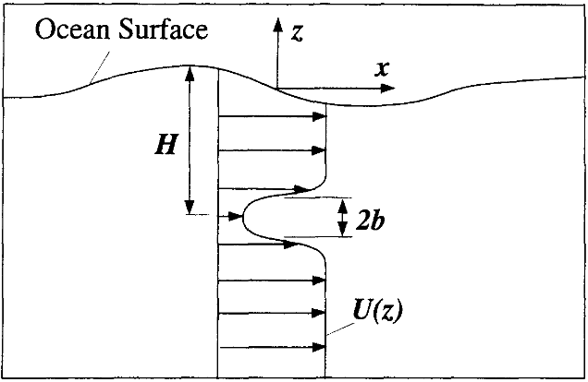
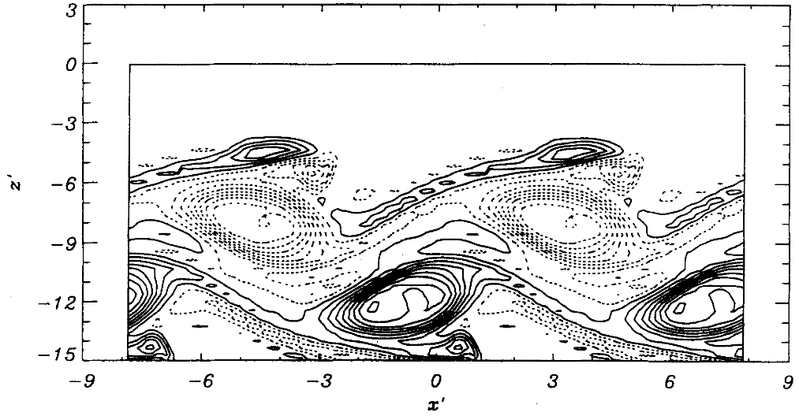
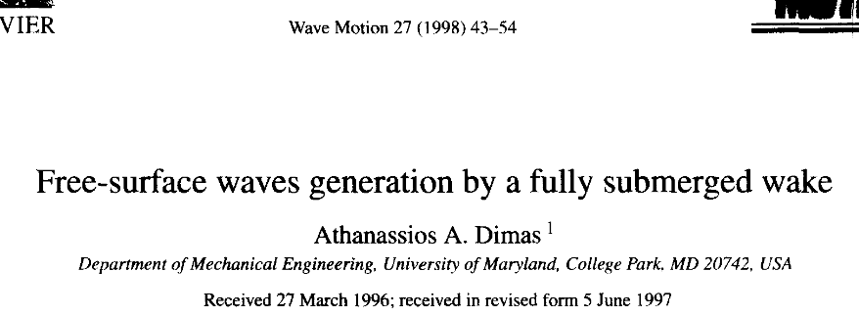

Free-surface waves generation by a fully submerged wake - 1
Simulation of nonlinear evolution of 2D inviscid fully submerged wake flow.
Numerical methods similar to Dimas & Triantafyllou (1994).
In a case with deep fully submerged wake at low Froude number (Branch I), the vortex street are identical to unbounded flow results. Wave breaking occurs at high Froude number (Branch II) or shallow submergence.
$$H=10, Fr=0.5$$
Return

Slide 17
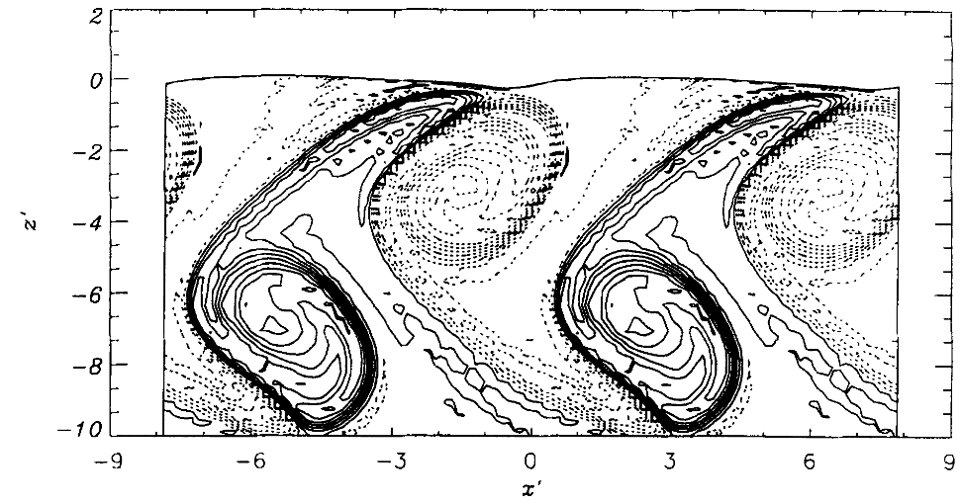
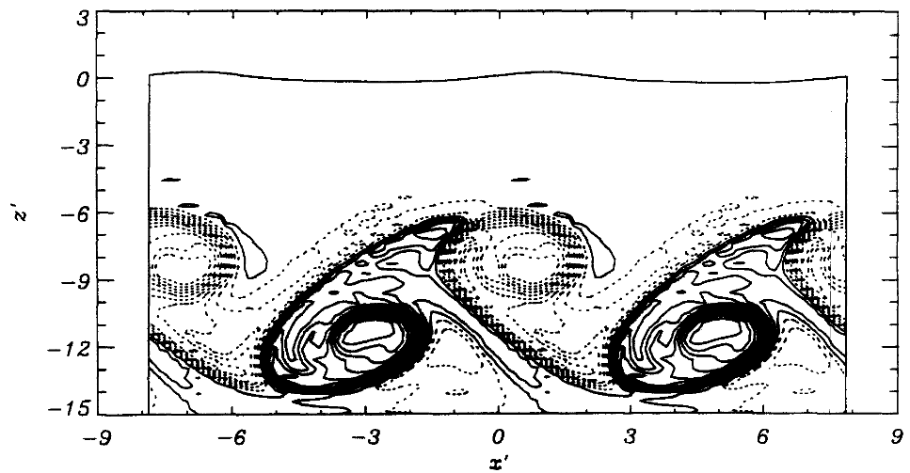
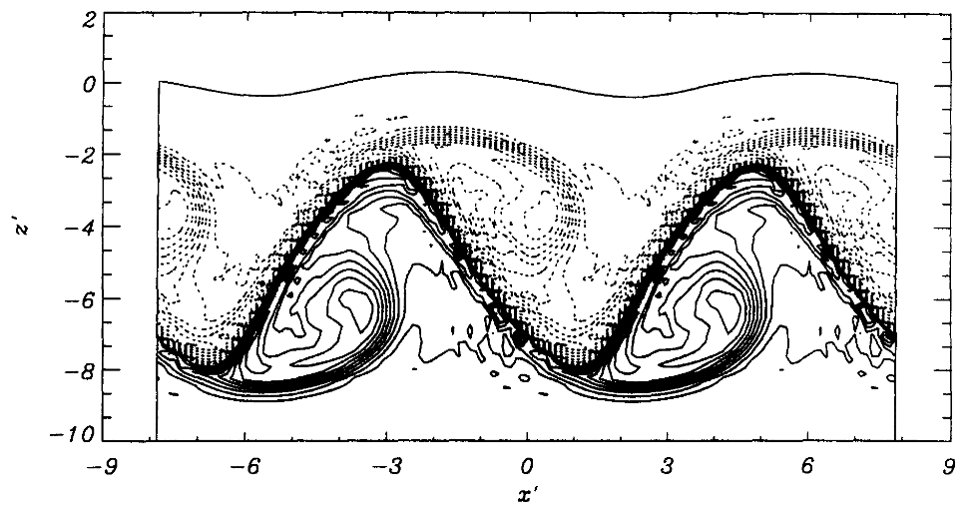




Free-surface waves generation by a fully submerged wake - 2
$$H=10, Fr=0.5$$
$$H=5, Fr=0.5$$
$H=10, Fr=1$00
$$H=10, Fr=5$$

Slide 18
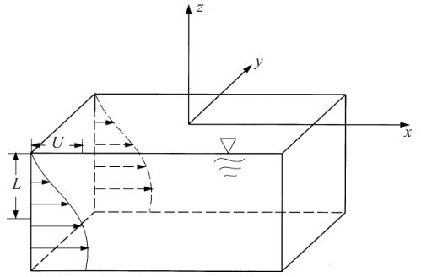
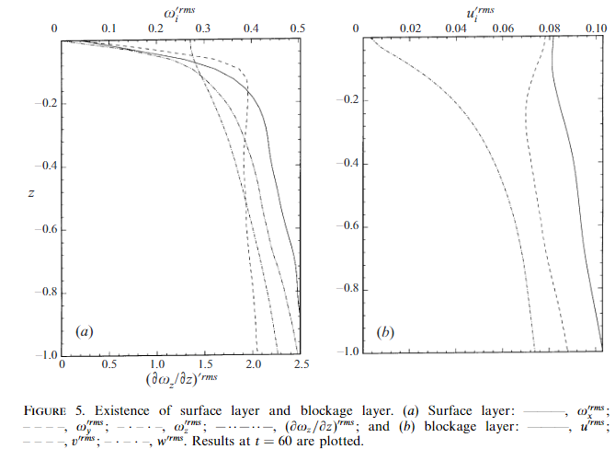
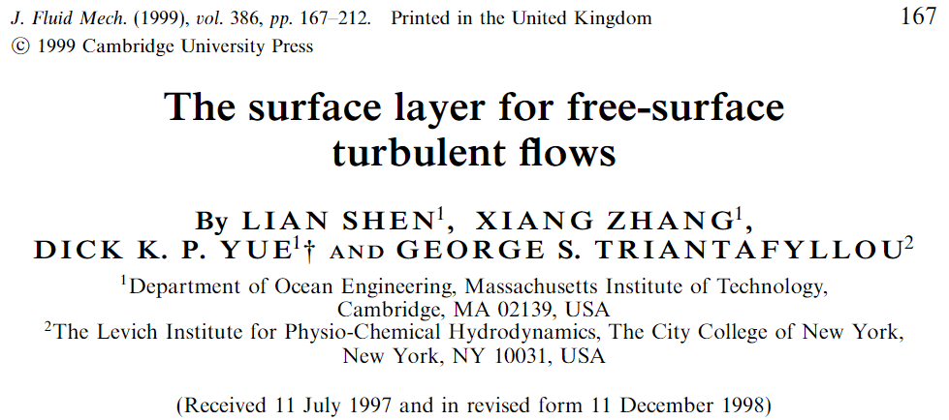

The surface layer for free-surface turbulent flows
Direct numerical simulation (DNS) for viscous shear flow ($Re=1000, Fr=0.7$).
Uses the velocity profile from Dimas(1989) only.
Finite difference in space (streamwise : sixth-order, vertical : second order), second-order Runge-Kutta in time.
Return

Slide 19





Linear instability of a particle-laden mixing layer with a dynamic dispersed phase
Spatial instability of a inviscid mixing layer (fluid phase, particulate phase).
The evaluation of spatial instability was achieved by solving spatial-temporal instability (three-point finite difference).
The two parameters:
$C_{p}$ related to the particle responsiveness, $C_{f}$ related to mean volume fraction.
Return

